Slide 1
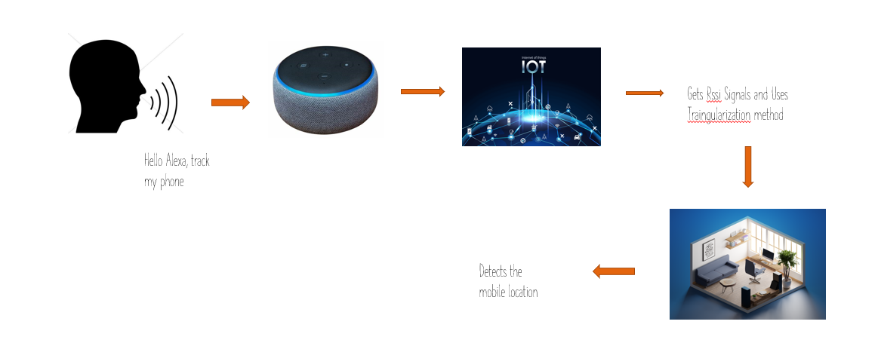
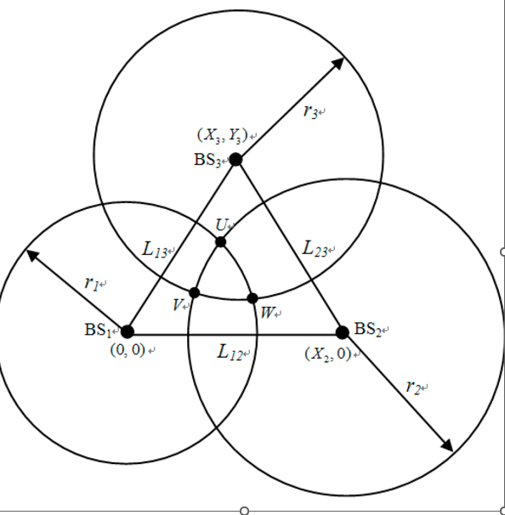

Indoor Localization Using Alexa
Sai Sharmila, Bhargav Santosh, Praneeth Reddy, Lalu Kishore, Sneha, Sivender, Riddhima, Venkatesh, Vamshi
Advisor: Dr. Sejun Song, University of Missouri – Kansas City
In recent years, there has been an increase in interest in positioning systems. A technique for determining an object's or person's precise location might be referred to as the positioning system. For use outdoors, we primarily rely on global navigation satellite systems like the GPS (Global Positioning System), however GPS cannot be used to locate items or people inside. Our main motivation is to create a system that can precisely locate and track the device inside the buildings.
MOTIVATION
CURRENT PROBLEM
IMPLEMENTATION
Physical barriers like tall buildings, dense forests, or tunnels can distort or entirely block GPS signals. A GPS receiver may struggle to give precise positional data if it cannot receive signals from many satellites.
GPS signals have difficulty penetrating buildings, making it challenging to obtain reliable indoor positioning.
The system uses various sensors such as Wi-Fi access points, ESP 32 Devices to detect a mobile within an indoor space. These sensors are strategically placed throughout the building to ensure comprehensive coverage.
The sensor data is transmitted to a cloud-based server, which processes the data and determines the mobile location using EC2 instance
The system is integrated with Amazon's Alexa voice assistant, which enables users to ask for directions or information about their current location using natural language commands.
The integration with Alexa's voice assistant adds an additional layer of functionality and ease of use, making the project an innovative and practical IoT solution for indoor localization
..
OUR SOLUTION
Here we develop an Alexa skill that incorporates the localization algorithm. This skill can receive the RSSI measurements from the device, perform the position estimation, and provide the user with the estimated location or perform location-based actions.
It is inexpensive and doesn't call for any additional hardware.
RSSI (RECEIVED SIGNAL STRENGTH INDICATOR)
In terms of dBm, RSSI represents the power level that was received by the sensor.
Using the following formulas, the distance (measured in meters) is calculated from the received power: where d0=8.838 meters and prd0=-56.98 decibels
Transmitter → RSSI -→ Reciverier
RSSI TRIANGULATION
It is a method for calculating a position that relies on a known distance between two measuring apparatuses and the measured angles from those two points to an object. This works using the angle-side-angle triangle congruency theorem to the find the location of an object.
However, RSSI only gives us the object's distance.
Using distances provided by the recievers,
we determine (X,Y) as coordinates of an object.
Triangulation is then used to determine the object's precise location.
CONCLUSION
We are able to successfully depict the precise location of objects indoors.The device will need to be accurately positioned inside the structures in the future, which will require more extensive path loss.
https://github.com/SharmiBonam/indoorLocalization

